Slide 1

Toco Sales Analysis: Unpacking Performance & Future Growth

Slide 2

Sales Performance Overview: Q1-Q3 2023 Trends
A comprehensive look at Toco's sales trajectory over the first three quarters of 2023 reveals both impressive gains and areas ripe for improvement. Understanding these trends is crucial for strategic planning.
Q1: Strong Start
Initial momentum driven by new product launches and aggressive marketing campaigns. Exceeded revenue targets by 15%.
Q2: Steady Growth
Maintained positive trajectory, with a focus on customer retention and subscription model expansion. Saw a 10% increase in recurring revenue.
Q3: Market Fluctuations
Faced unexpected market shifts and increased competition, leading to a slight dip below projections. Ended with 5% growth year-over-year.

Slide 3


Key Drivers & Challenges: What's Moving the Needle (or Not)?
Identifying the factors influencing our sales performance is critical. We analyze both the positive catalysts and the obstacles hindering our growth.
Key Drivers of Success
Persistent Challenges
Innovative Product Line
Intense Competition
Our cutting-edge products continue to attract new customers and drive repeat business.
A crowded market requires constant innovation and differentiation to stand out.
Customer Loyalty
Supply Chain Disruptions
High satisfaction rates translate to strong retention and valuable word-of-mouth referrals.
Unforeseen delays have occasionally impacted product availability and delivery times.
Effective Marketing
Economic Uncertainty
Targeted campaigns and digital presence have significantly boosted brand awareness.
Fluctuating economic conditions influence consumer spending habits, posing a challenge.

Slide 4

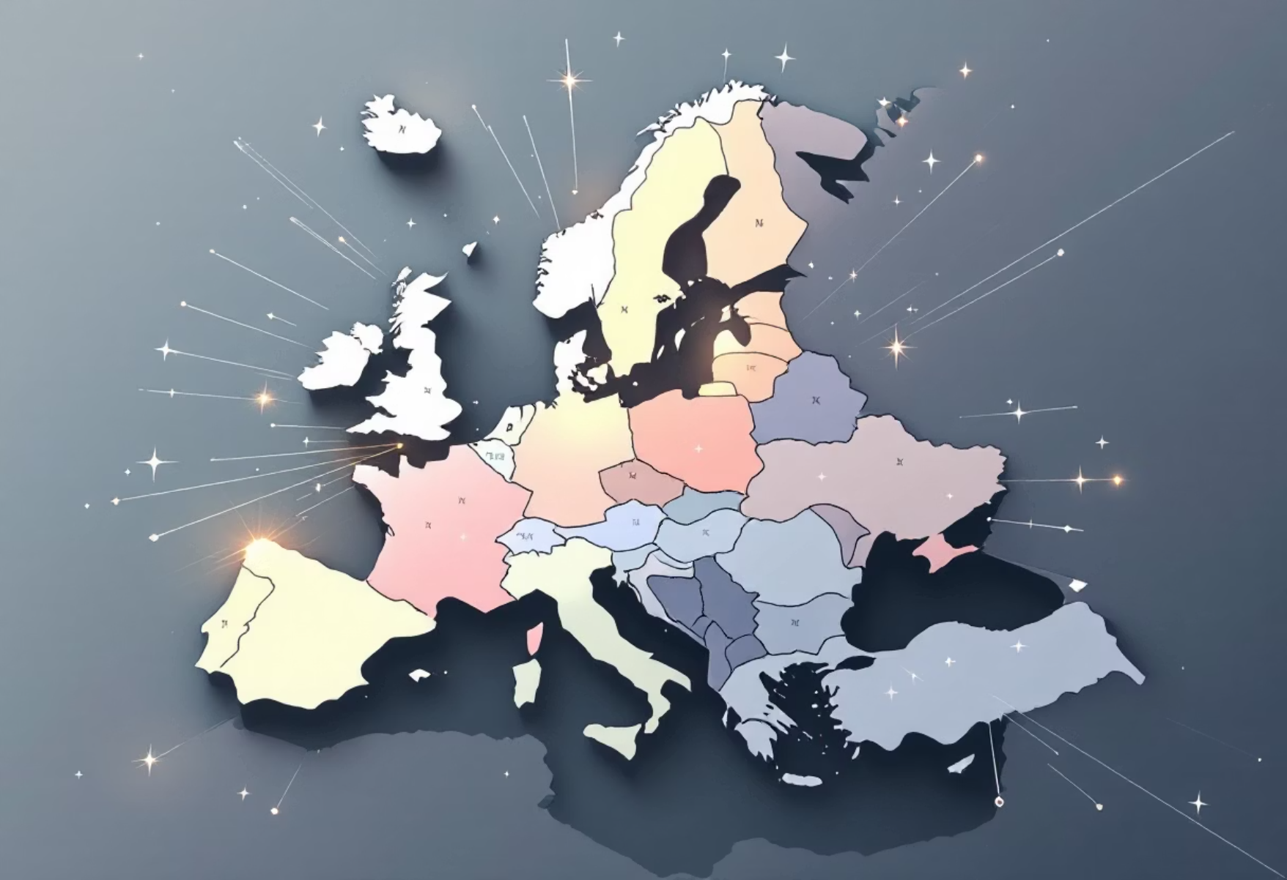
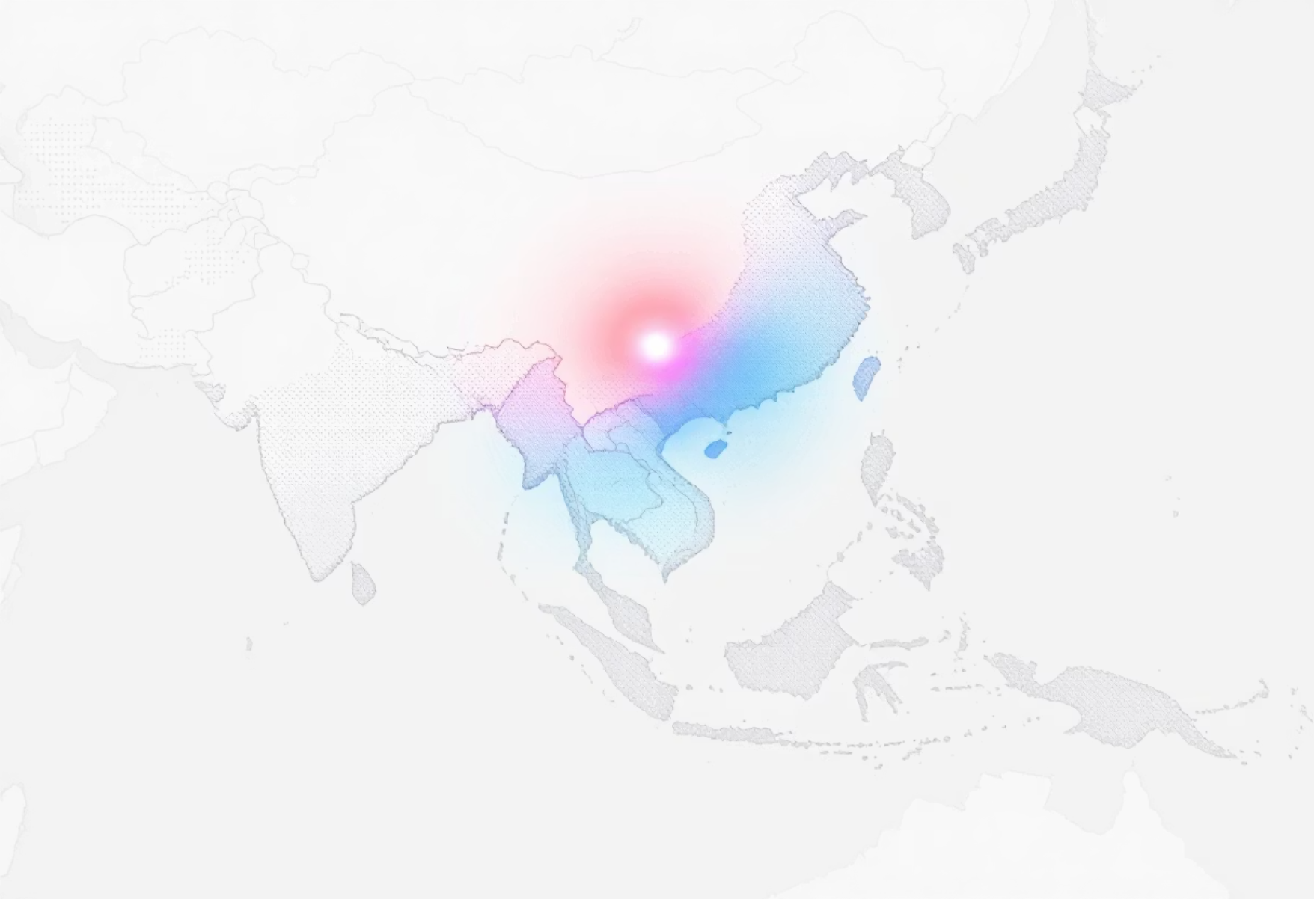
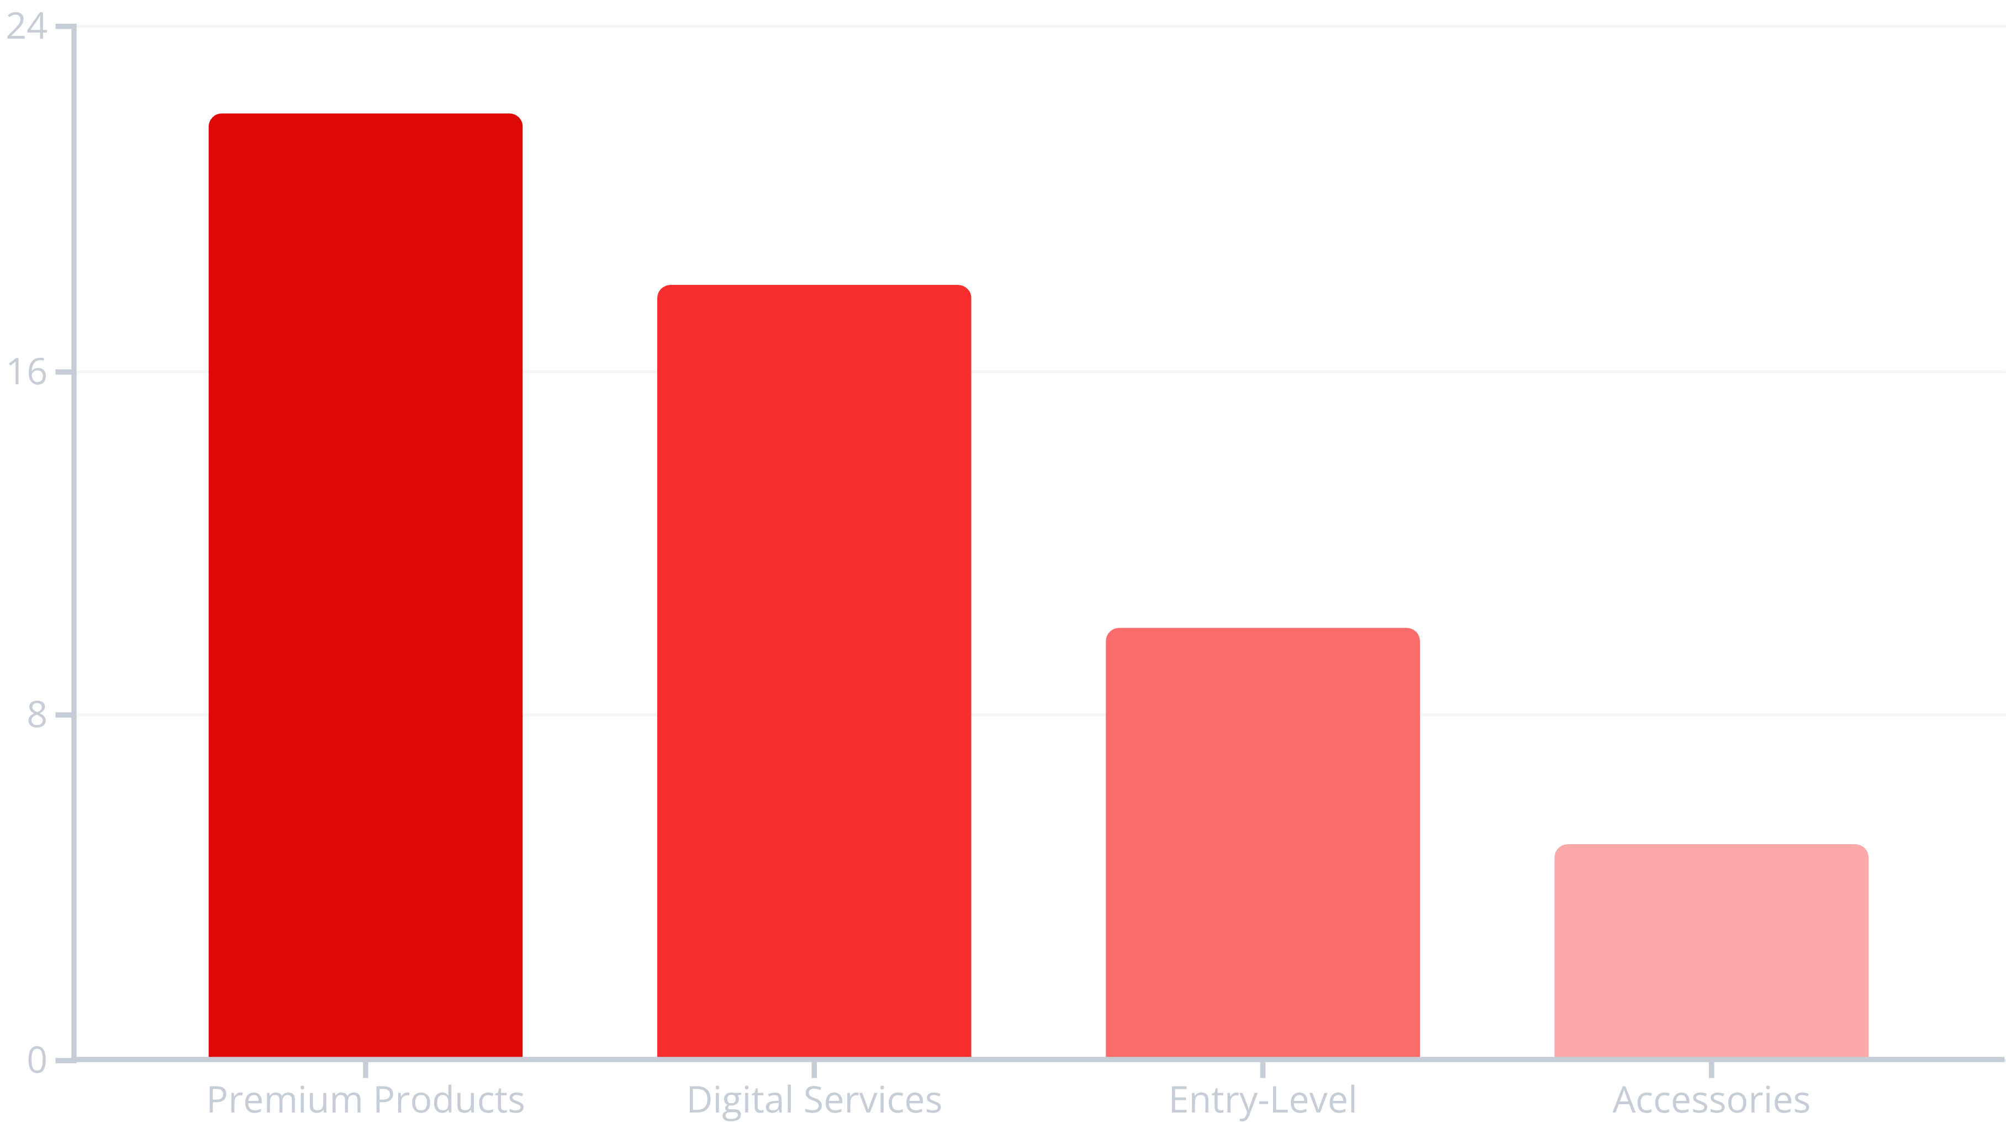
Regional & Product Deep Dive: Identifying Strengths & Weaknesses
A granular analysis of our performance across different regions and product categories reveals where we're excelling and where we need to re-strategize.
North America: Steady Growth
Leading region with consistent sales, particularly in our premium product lines. Opportunities for further market penetration.
Europe: Emerging Market
Showing promising signs, especially in new customer acquisition for digital services. Requires focused investment.
Asia-Pacific: High Potential
Significant untapped potential. Current sales are moderate, but entry-level products are gaining traction.
Product Category Performance:

Slide 5

Recommendations & Next Steps: Strategizing for Q4 & Beyond
Based on our analysis, we propose a strategic roadmap to optimize Q4 performance and lay a strong foundation for future growth.
Boost Q4 Sales
Launch targeted holiday campaigns and leverage regional strengths with localized promotions in North America.
Innovate & Diversify
Accelerate development of new digital services for the European market and explore partnerships in Asia-Pacific.
Optimize Operations
Invest in supply chain resilience and enhance customer support for improved satisfaction across all regions.
Monitor & Adapt
Continuously track market trends, competitive landscape, and customer feedback to remain agile and responsive.

